Slide 1
Using Static Members

Slide 2

Static member overview
Static fields
Overview
Static methods
Static import statement Static initialization blocks

Slide 3
Static members are shared class-wide
- Not associated with individual instance
Static Members
Declared using the static keyword
- Accessible using the class name

Slide 4

Static Members
Field
A value not associated with a specific instance
All instances access the same value

Slide 5
public class Flight {
private int passengers, seats = 150; private static int allPassengers; public void add1Passenger() {
Flight.java
if(passengers < | seats) | {
passengers += | 1;
allPassengers | += 1;
}
}
// other members elided
}

Slide 6

Static Members
Field
A value not associated with a specific instance
All instances access the same value
Method
Performs an action not tied to a specific instance
Has access to static members only

Slide 7
public class Flight {
private int passengers, seats = 150; private static int allPassengers; public static int getAllPassengers() {
Flight.java
return allPassengers;
}
public static void resetAllPassengers() { allPassengers = 0;
}
// other members elided
}

Slide 8
Flight.allPassengers
Main.java
0
Flight laxToSlc = new Flight();
laxToSlc
passengers
0
seats
dfwToNyc
150
Flight dfwToNyc = new Flight();
passengers
0
seats
150

Slide 9
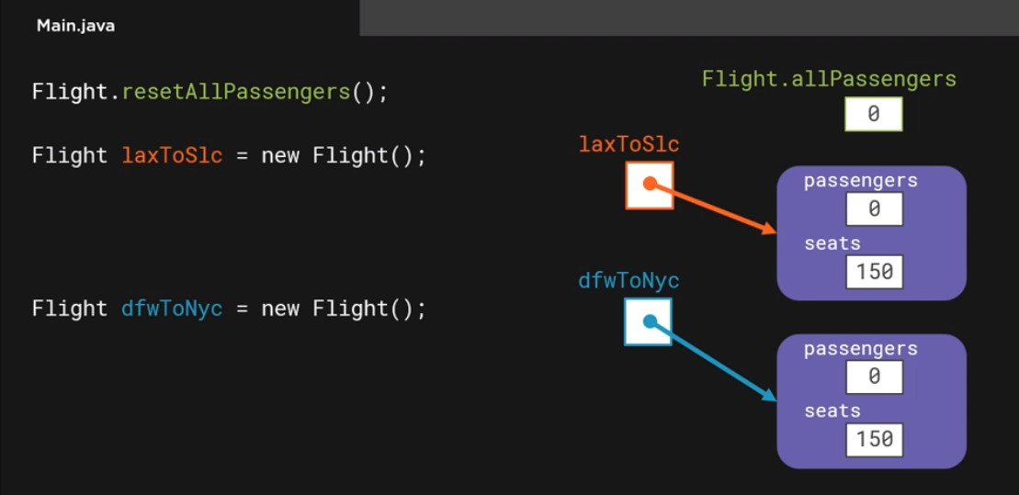

Slide 10
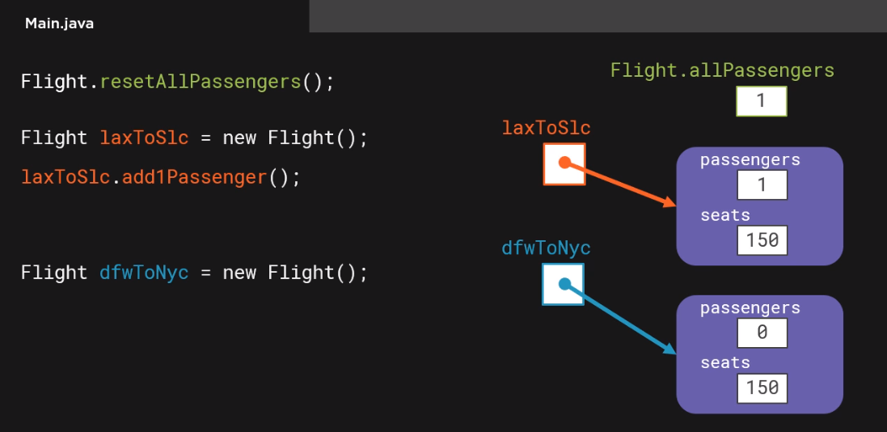

Slide 11
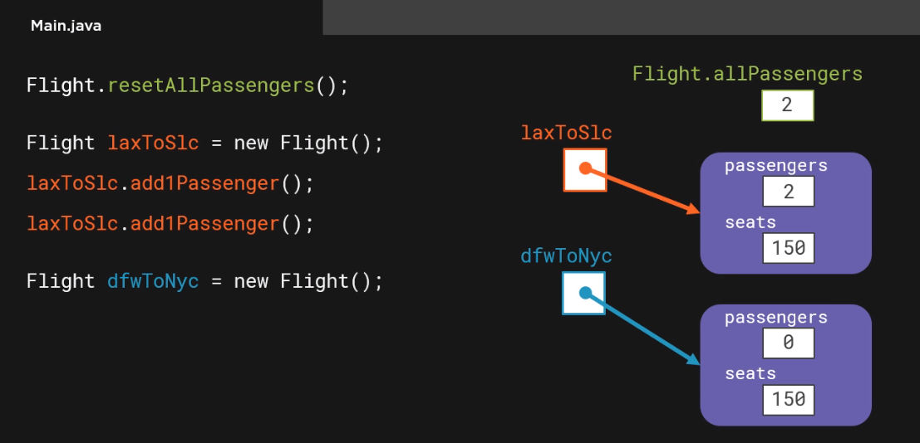

Slide 12
Flight.allPassengers
Main.java
Flight.resetAllPassengers();
3
Flight laxToSlc = new Flight();
laxToSlc.add1Passenger(); laxToSlc.add1Passenger();
laxToSlc
passengers
2
seats
dfwToNyc
150
Flight dfwToNyc = new Flight();
dfwToNyc.add1Passenger();
passengers
1
System.out.println(laxToSlc.getPassengers()); // 2
System.out.println(dfwToNyc.getPassengers()); // 1
System.out.println(Flight.getAllPassengers()); // 3
seats
150

Slide 13
Import statement
- Allows a type name to be used without being package-qualified
Static Import Statement
Static import statement
Used with static methods
Allows method name to be used without being class-qualified

Slide 14
import static com.mycompany.flightapp.Flight.resetAllPassengers;
Main.java
Flight.resetAllPassengers();
Flight laxToSlc = new Flight(); laxToSlc.add1Passenger(); laxToSlc.add1Passenger();
Flight dfwToNyc = new Flight(); dfwToNyc.add1Passenger();
System.out.println(Flight.getAllPassengers());

Slide 15
import static com.pluralsight.flightapp.Flight.resetAllPassengers;
import static com.pluralsight.flightapp.Flight.getAllPassengers;
Main.java
resetAllPassengers();
Flight laxToSlc = new Flight(); laxToSlc.add1Passenger(); laxToSlc.add1Passenger();
Flight dfwToNyc = new Flight(); dfwToNyc.add1Passenger();
System.out.println(Flight.getAllPassengers());

Slide 16
import static com.pluralsight.flightapp.Flight.resetAllPassengers;
import static com.pluralsight.flightapp.Flight.getAllPassengers;
Main.java
resetAllPassengers();
Flight laxToSlc = new Flight(); laxToSlc.add1Passenger(); laxToSlc.add1Passenger();
Flight dfwToNyc = new Flight(); dfwToNyc.add1Passenger();
System.out.println(getAllPassengers());

Slide 17
import static com.pluralsight.flightapp.Flight.*;
Main.java
resetAllPassengers();
Flight laxToSlc = new Flight(); laxToSlc.add1Passenger(); laxToSlc.add1Passenger();
Flight dfwToNyc = new Flight(); dfwToNyc.add1Passenger();
System.out.println(getAllPassengers());

Slide 18

Static Initialization Blocks
Perform one-time type initialization
Execute before type’s first use
Has access to static members only
Statements enclosed in brackets
Preceded by static keyword
Outside of any method or constructor

Slide 19
public class Flight {
Flight.java
private int passengers, seats = 150;
private static int allPassengers, maxPassengersPerFlight;
static {
AdminService admin = new AdminService(); admin.connect();
maxPassengersPerFlight = admin.isRestricted() ? admin.getMaxFlightPassengers() : Integer.MAX_VALUE;
admin.close();
}

Slide 20
public void add1Passenger() {
Flight.java
if(passengers < | seats) | {
passengers += | 1;
allPassengers | += 1;
}
}
// other members elided
}

Slide 21
public void add1Passenger() {
if(passengers < seats && passengers < maxPassengersPerFlight) { passengers += 1;
Flight.java
allPassengers += 1;
}
}
// other members elided
}

Slide 22
Summary
Static members
Shared class-wide
Declared using the static keyword

Slide 23
Static fields
Summary
Values not associated with an instance
All instances access the same value
Static method
Perform action not tied to an instance
Can only access static members

Slide 24
Static import statement
Summary
- Allows static methods to be used without being class-qualified
Static initialization blocks
Perform one-time type initialization
Execute before type’s first use

